Slide 1
User Interface Evaluation
Formative
and Summative
Evaluation

Slide 2

Summative Evaluation
Evaluation of the user interface after it has been developed.
Typically performed only once at the end of development. Rarely used in practice.
Not very formal.
Data is used in the next major release.

Slide 3
Formative Evaluation
Evaluation of the user interface as it is being developed.
Begins as soon as possible in the development cycle.
Typically, formative evaluation appears as part of prototyping.
Extremely formal and well organized.

Slide 4
Formative Evaluation
Performed several times.
  An average of 3 major cycles followed by iterative redesign per version released
  First major cycle produces the most data.
  Following cycles should produce less data, if you did it right.

Slide 5
Formative Evaluation Data
Objective Data
  Directly observed data.
  The facts!
Subjective Data
  Opinions, generally of the user.
  Some times this is a hypothesis that leads to additional experiments.

Slide 6
Formative Evaluation Data
Quantitative Data
  Numeric
  Performance metrics, opinion ratings (Likert Scale)
  Statistical analysis
  Tells you that something is wrong.
Qualitative Data
  Non numeric
  User opinions, views or list of problems/observations
  Tells you what is wrong.

Slide 7
Formative Evaluation Data
Not all subjective data are qualitative.
Not all objective data are quantitative.
Quantitative Subjective Data
  Likert Scale of how a user feels about something.
Qualitative Objective Data
  Benchmark task performance measurements where the outcome is the expert’s opinion on how users performed.

Slide 8
Steps in Formative Evaluation
Design the experiment.
Conduct the experiment.
Collect the data.
Analyze the data.
Draw your conclusions & establish hypotheses
Redesign and do it again.

Slide 9
Experiment Design
Subject selection
  Who are your participants?
  What are the characteristics of your participants?
  What skills must the participants possess?
  How many participants do I need (5, 8, 10, …)
  Do you need to pay them?

Slide 10
Experiment Design
Task Development
  What tasks do you want the subjects to perform using your interface?
  What do you want to observe for each task?
  What do you think will happen?
  Benchmarks?
  What determines success or failure?

Slide 11
Experiment Design
Protocol & Procedures
  What can you say to the user without contaminating the experiment?
  What are all the necessary steps needed to eliminate bias?
  You want every subject to undergo the same experiment.
  Do you need consent forms (IRB)?

Slide 12
Experiment Trials
Calculate Method Effectiveness
  Sears, A., (1997) “Heuristic Walkthroughs: Finding the Problems Without the Noise,” International Journal of Human-Computer Interaction, 9(3), 213-23.
Follow protocol and procedures.
  Pilot Study
Expect the unexpected.

Slide 13
Experiment Trials
Pilot Study
  An initial run of a study (e.g. an experiment, survey, or interview) for the purpose of verifying that the test itself is well-formulated. For instance, a colleague or friend can be asked to participate in a user test to check whether the test script is clear, the tasks are not too simple or too hard, and that the data collected can be meaningfully analyzed.
  (see http://www.usabilityfirst.com/ )

Slide 14
Data Collection
Collect more than enough data.
  More is better!
Backup your data.
Secure your data.

Slide 15
Data Analysis
Use more than one method.
All data lead to the same point.
  Your different types of data should support each other.
Remember:
  Quantitative data tells you something is wrong.
  Qualitative data tells you what is wrong.
  Experts tell you how to fix it.

Slide 16
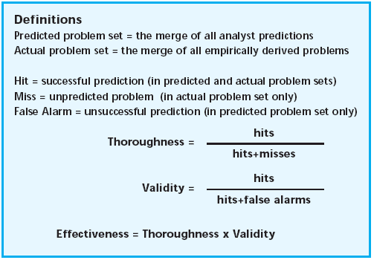
Measuring Method Effectiveness

Slide 17
Conclusions
The data should support your conclusions.
  Method Effectiveness Measure
Make design changes based upon the data.
Establish new hypotheses based upon the data.

Slide 18
Redesign
Redesign should be supported by data findings.
Setup next experiment.
  Sometimes it is best to keep the same experiment.
  Sometimes you have to change the experiment.
  Is there a flaw in the experiment or the interface?

Slide 19
Formative Evaluation Methods
Usability Inspection Methods
  Usability experts are used to inspect your system during formative evaluation.
Usability Testing Methods
  Usability tests are conducted with real users under observation by experts.
Usability Inquiry Methods
  Usability evaluators collect information about the user’s likes, dislikes and understanding of the interface.

